Slide 1
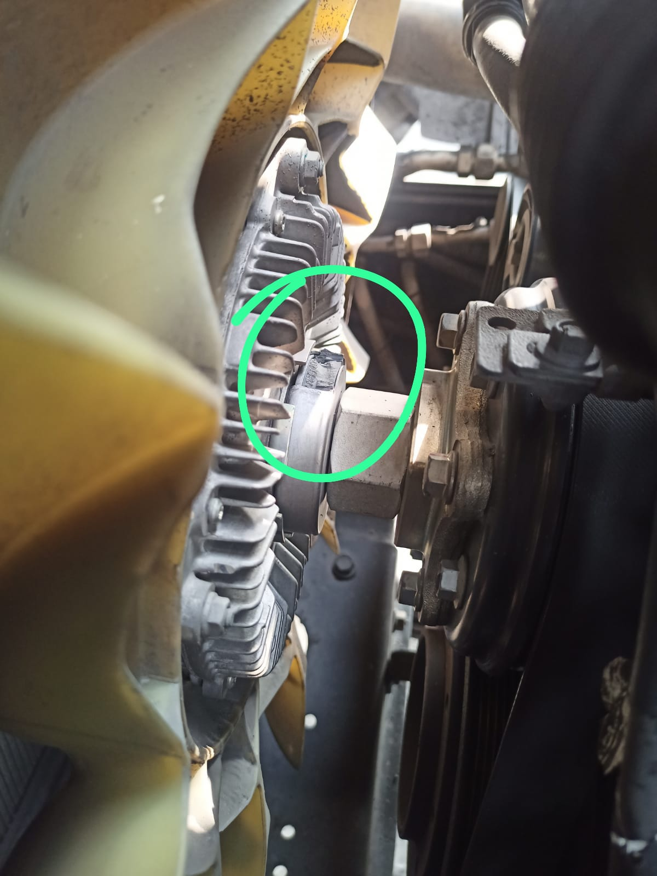
Ref/ Failure Date : Protus : Pro 6048HT vehicle – 26 Nov, 2024
Complaint : Pro6048HT_Singruali_Errror code for P04801_E-Viscous FANs actuator signal Open Circuit
Part’s mileage/cumulative mileage/target : 83,091 Km kms (7622 Hrs )
Vehicle ID : Pro 6048HT vehicle Vehicle ID-9126 -MC2HCSRC0PE096305
Durability test at : Coal application _Singrauli MP
1 | 5 | 25 | 100
Author, Date:Supal singh,25 Nov, 2024
Design Engineer:-Ashish Jain
PICTURE
Part No: ID380917
Part name :- Fan harness pigtail
P048013 E-Viscous FANs actuator signal Open Circuit.
Observation:-
From telematics daily tracking below are the error code appearing
Pro6048HT_Singruali_Errror code for P04801_E-Viscous FANs actuator signal Open Circuit
Same issue is observed in below chassis also
MC2HCSRC0PB090278
History :
Vehicle is running at Singrauli-Coal Application.
Probable cause:-
Action taken
Vehicle to to be attend
MC2HCSRC0PB090278

Slide 2
PROTUS statement :- Pro6048HT_Singruali_Errror code for P04801_E-Viscous FANs actuator signal Open Circuit
Why/Why | Why/Why -RCA (Fact finding) | Reasons for Problem | Corrective action with relevant document evidence
Why1 | DTC code for P04801 | As per the vehicle history details from field team :- Harness fuse observed with dust content. | After cleaning of Fuse and re-assemble problem solved
Why 2 | Dust on Fuse | Due to application of the vehicle, Regular cleaning by high pressure water nozzle by customer. | Serviceable Fuse design , Released and implemented
Note:- As per vehicle service history
Why 5
Design issue (Y/N) | Quality issue (Y/N)
N | N
Process Issue (Y/N) | Others:-(Deviation / Handling)
N | Y
Attachment :-
(CAPA/8D/Deviation /Fishbone
Prevent recurrence of the problem at the problem site and across the organization
Document Updation / Related activities | Applicability (Y/N) | In-House /Vendor | Resp | Target Date | Status | Date of Closure
PFMEA/DFMEA | N |  | Design rep
PPAP | N
Process Flow/AOS | N |  | ME Rep
SOP Update | N |  | PMO rep
Process Audit Sheet | N |  | QA Rep
Quality / Gate Check Sheet | N
Action in Stores | N
ECO / Drawing | Y |  | Design rep | Done | Drawing released | Done
Resolution in Field | Y |  | Q&CS rep | Done | WH updated | Done
Failed Part( Rel lev) | Make -
ID380917 - B | BW
PR No | ECO No
NP-30082024-39 | CA-24-00039748
RCA reviewed By:-
A.JAIN

Slide 3
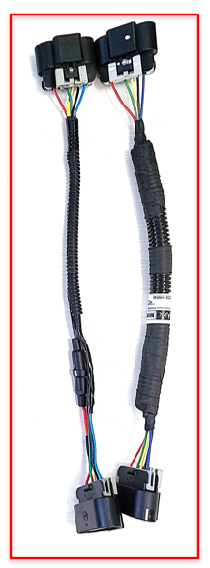
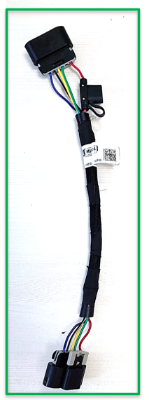
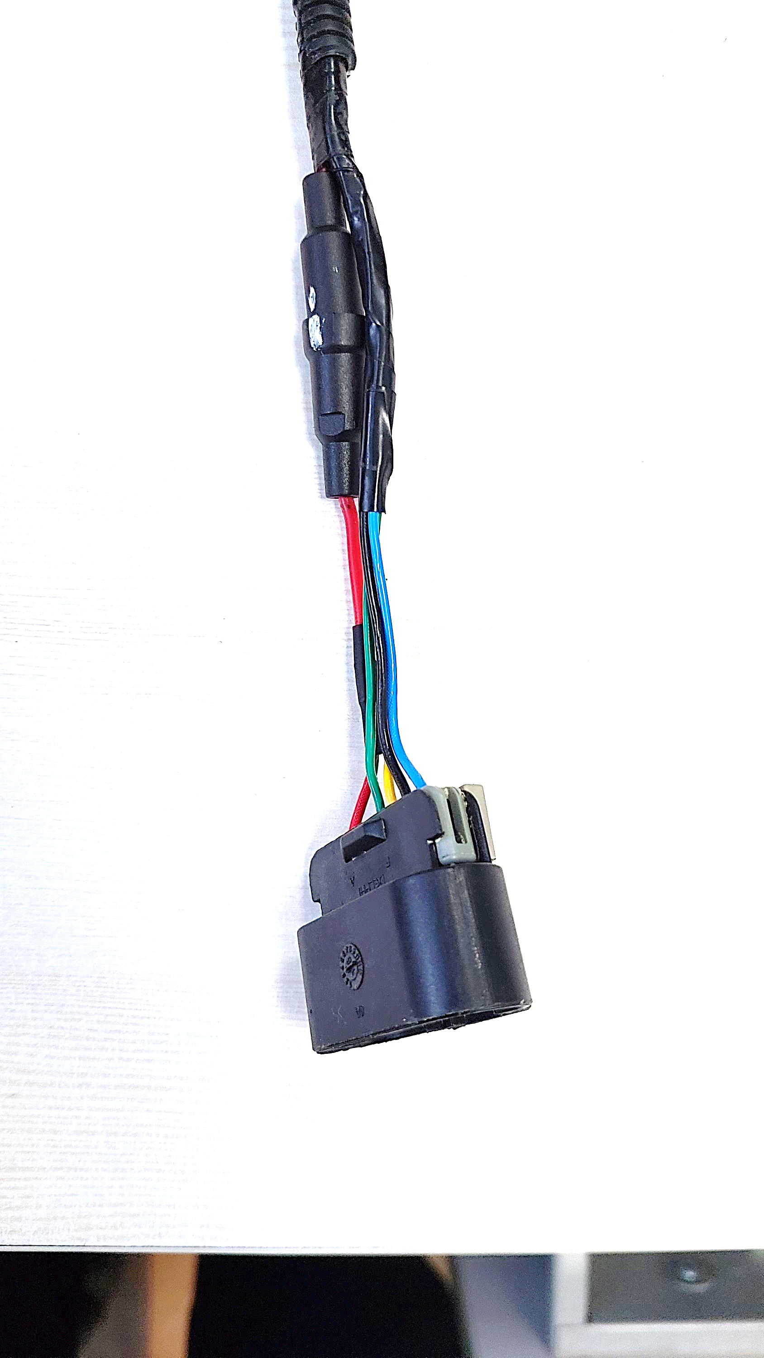
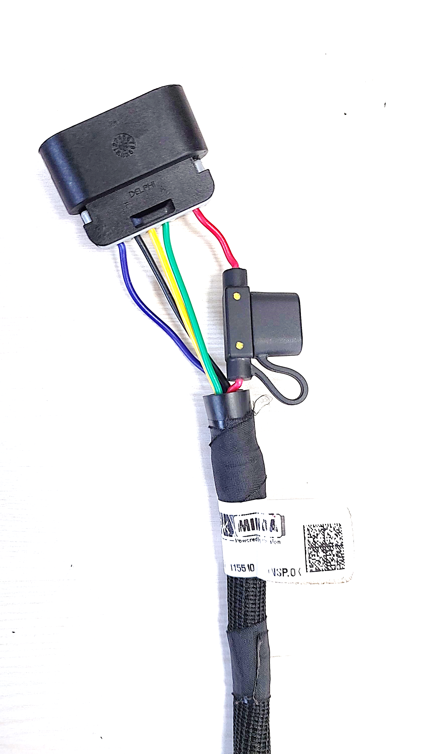
Change Details
Existing fan jumper harness
New fan jumper harness
Vehicle side
harness connector
Vehicle side
harness connector
Aftermarket serviceable fuse
Added fuse part number IE463173
Fan jumper harness ID380917_B
Fuse use as non-serviceable
Fan jumper harness ID380917_A
Wiring harness improved with:
1 Sq.mm wire thickness (125 deg. temp capability). 150 deg. Wire under development with supplier.
Blade type fuse
1 part with existing corrugated tube & 1 part with Nu-guard (150 deg. temp capability)
Grommets at both ends of tube.
FUSE
Fan wiring harness
ID628999
Grommet
FUSE IE463173
Grommet
Fan side connector
Fan side connector
3

Slide 4
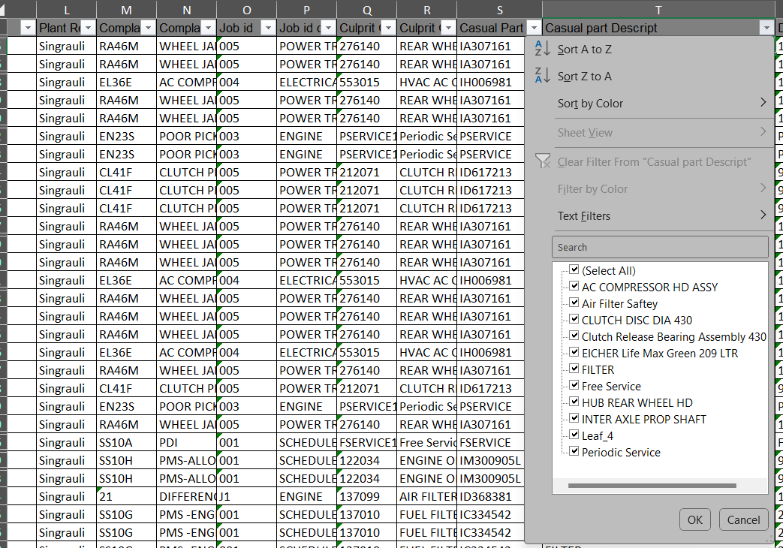
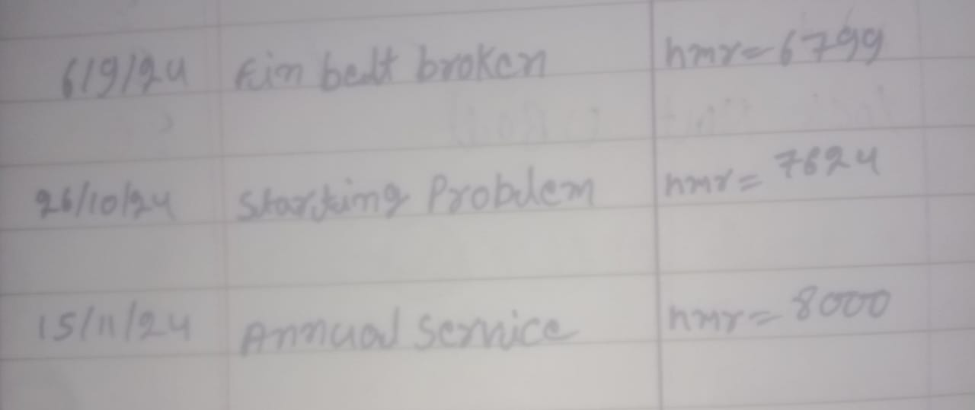
Vehicle service history and Logbook data at Field.
Vehicle history :- Observation → Nothing is changed related FEAD system
As per the discussion with Field technician :→
Fan Belt broken due to Alternator Jam → Alternator changed in field by supplier
No change details mentioned in the vehicle history.

Slide 5
BW- fan and drive assembly (ID341157)
LIVE CASE – Attended
Fan fully engage with active DTC P0480 -13
Below action already taken to resolve this issue.
S.No | Failure Mode | Action | Cutoff date | Action implementation
1 | Fan Engaged > Fan continuous on > Harness/Actuator damage | Transporter has been changed from Safe Express to Shubham Logistics. 100% Inspection of parts at Transporter will be done by the local representative | 23/05/2023 | Implemented
3 | Jumper harness damage | Taping length maintained as 30mm from the connector. | 17/05/2023 | Implemented
 |  | Wiring harness improved with – 1Sq.mm wire thickness (125 deg. temp capability). 150 deg. Wire underdevelopment with supplier. Blade type fuse with corrugated tube Grommets added at both ends of tube. | 03/07/2024 | CA-24-00039748 Implemented
4 | Fan not engaged > Fan not working > Shaft free rotation | The supplier will now deliver the "drive + spacer" as a single integrated part. The new assembly process introduce in production line. fan directly mount on coolant pump with stud and nut. |  | C-release completed CA-24-00040919 IVS trial Completed (29-11-2024)

Slide 6
LIVE CASE - Fan fully engage with active DTC P0480 -13
Summery
Total four vehicle attend on field
Attend vehicle for live case- fan fully engaged with active DTC P0480-13
Joint Analysis by:
Shubham Shukla - Volvo Eicher
Satheesh kumar - BorgWarner
Ramanand - Eicher service
Date - 13th & 14th Aug 2024
Location - Singrauli, MP
SR. No. | Chassis No. | Problem | DTC | Observation | Remark
1 | MC2HCSRC0PE097378 | Fan Fully Engaged | DTC P0480 -13 | Fan Actuator found crack | Replaced the fan drive assembly and conducted fan test. The active DTC P0480-13 was resolved, and the fan system returned to normal operation. According to the Service History (SH), no parts were recorded as replaced. However, after discussing with the service team, it was confirmed that the vehicle was reported for service on 19th June 2024 due to a jammed alternator pulley and broken fan belt. The broken belt was replaced on the same day, but the Service History does not reflect this replacement.
2 | MC2HCSRC0PE096305 | Fan Fully Engaged | No DTC | Fan Working fine | DTC Status: No DTCs were found. Fan System: The fan is operating normally,
3 | MC2HCSRC0PE096304 | Fan Fully Engaged | DTC P0480 -13 | Fan Actuator totally damage | DTC Status: Active DTCs were found, specifically DTC P0480-13. Fan System: The fan is operating in a fully engaged condition. Observation: The fan actuator is found to be totally damaged. According to the Service History (SH), the alternator was replaced at an odometer reading of 2836 hours due to a noise issue. Vehicle is running with broken fan till now
4 | MC2HCSRC0PB090273 | Fan Fully Engaged | DTC P0480 -13 | Fan Actuator totally damage | DTC Status: Active DTCs were found, specifically DTC P0480-13. Fan System: The fan is operating in a fully engaged condition. Observation: The fan actuator is found to be totally damaged. Service History: There are no observations or recorded details in the Service History (SH) sheet related to the fan system issue.

Slide 7
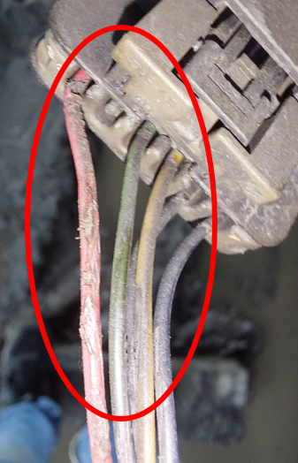
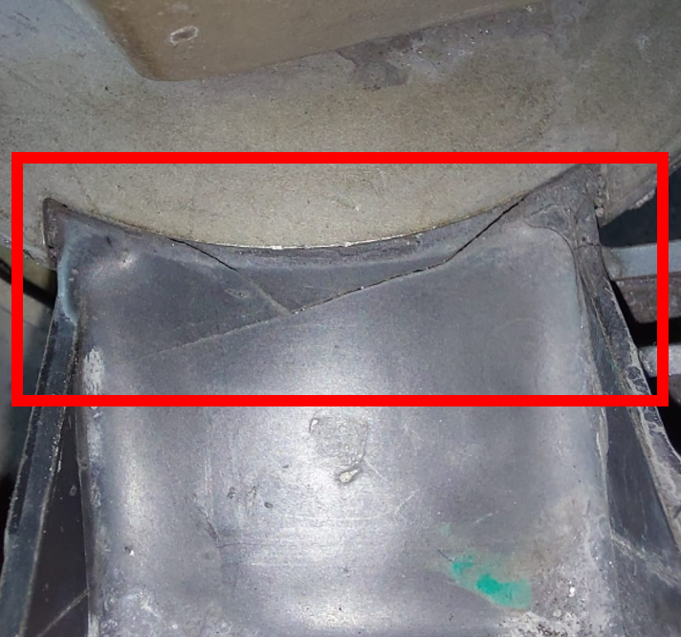
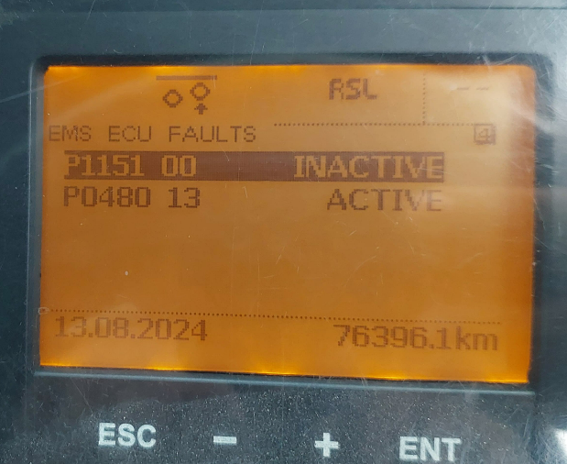
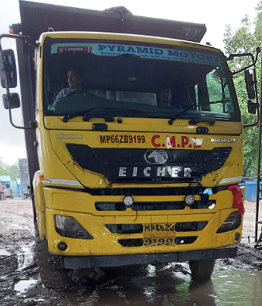
LIVE CASE - Fan fully engage with active DTC P0480 -13
Vehicle-1
Chassis no -MC2HCSRC0PE097378
Vehicle Registration Number – MP66ZB9199
Vehicle model – PRO6048T
ODO reading – 6961 hrs / 76396 kms
Issue :- DTC P0480 -13
Concern :- Fan fully engaged
Field Observation and Steps Taken
Initial Inspection:
Attended the vehicle for a live case with the fan continuously engaged and DTC P0480-13 active.
Conducted a fan test which confirmed that the fan was in a continuous engagement condition.
Measured the Engine input voltage. Found 25.4V, Fan drive harness & fuse verified and found OK
Verification and Actions Taken:
Arranged for a vehicle in good working condition for comparison. Verified that the fan system was functioning correctly on the comparison vehicle.
Replaced the fan harness and performed another fan test. Despite the replacement, the fan remained continuously on or engage condition
Replaced the fan drive assembly and conducted another test. The active DTC P0480-13 was resolved, and the fan system returned to normal operation.
Further Investigation:
Discovered damage to the fan harness and a crack in the fan actuator.
Field support engineer’s observation indicated that the crack in the fan actuator was caused by belt failure due to a jammed alternator pulley.
According to the Service History (SH), no parts were recorded as replaced. However, after discussing with the service team, it was confirmed that the vehicle was reported for service on 19th June 2024 due to a jammed alternator pulley and broken fan belt. The broken belt was replaced on the same day, but the Service History does not reflect this replacement.

Slide 8
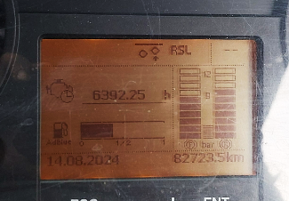
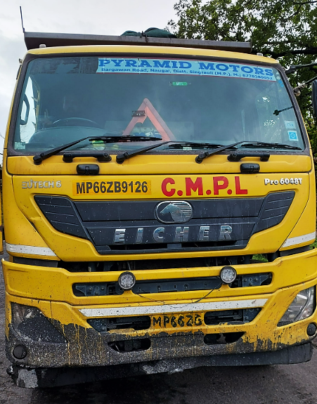
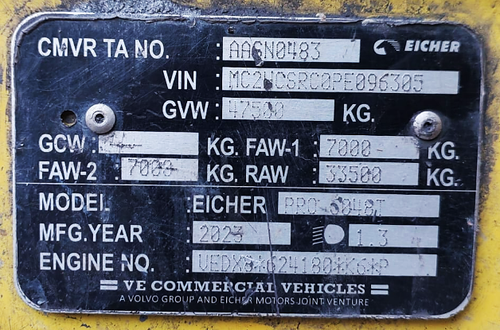
LIVE CASE - Fan fully engage with active DTC P0480 -13
Vehicle-2
Chassis no - MC2HCSRC0PE096305
Vehicle Registration Number – MP66ZB9126
Vehicle model – PRO6048T
ODO reading – 6392 hrs / 82723 kms
Issue :- DTC P0480 -13
Concern :- Fan fully engaged
Field Observation and Steps Taken
DTC Status: No DTCs were found.
Fan System: The fan is operating normally,

Slide 9
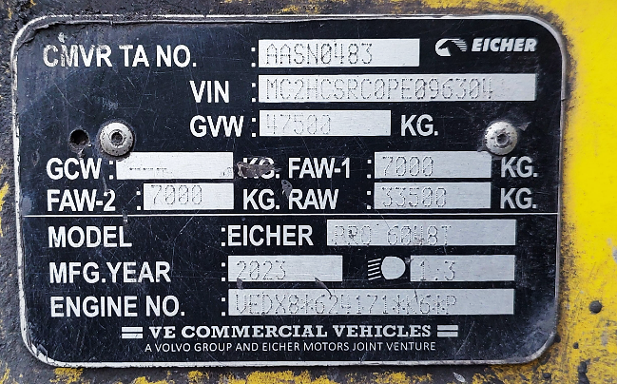
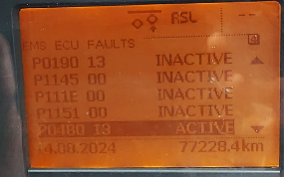
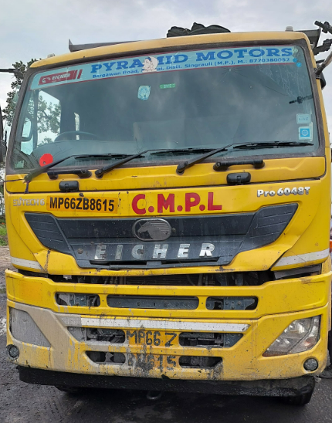
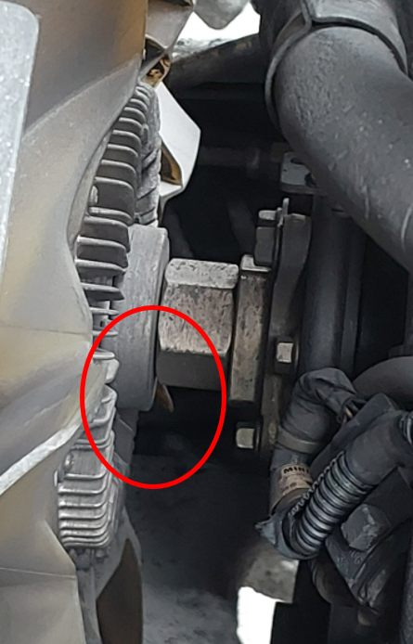
LIVE CASE - Fan fully engage with active DTC P0480 -13
Vehicle-3
Chassis no - MC2HCSRC0PE096304
Vehicle Registration Number – MP66ZB8615
Vehicle model – PRO6048T
ODO reading – 6918 hrs / 77228 kms
Issue :- DTC P0480 -13
Concern :- Fan fully engaged
Field Observation and Steps Taken
DTC Status: Active DTCs were found, specifically DTC P0480-13.
Fan System: The fan is operating in a fully engaged condition.
Observation: The fan actuator is found to be totally damaged.
Field support worker’s observation indicates that the crack in the fan actuator resulted from belt failure.
According to the Service History (SH), the alternator was replaced at an odometer reading of 2836 hours due to a noise issue.

Slide 10
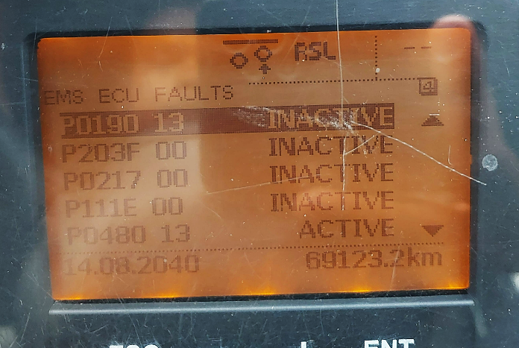
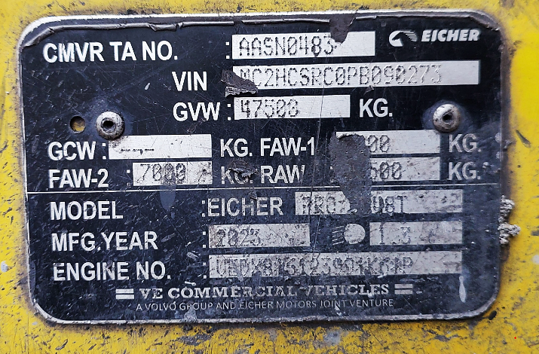
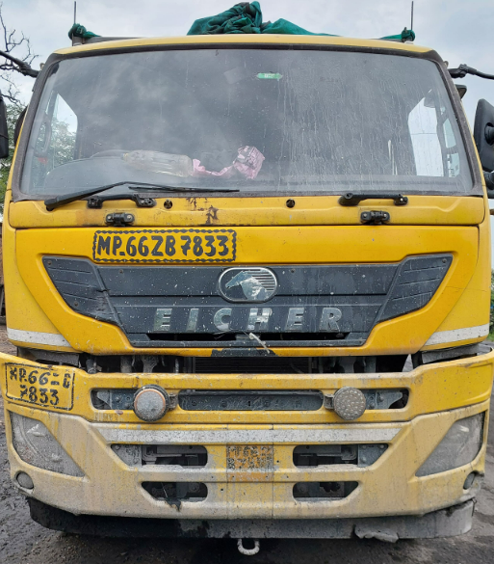
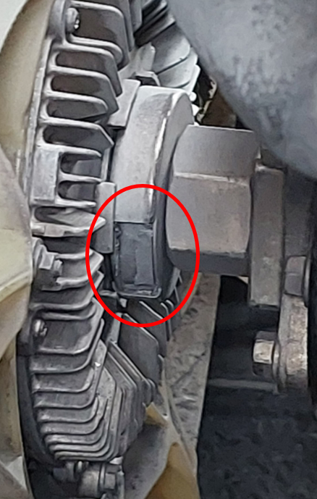
LIVE CASE - Fan fully engage with active DTC P0480 -13
Vehicle-4
Chassis no - MC2HCSRC0PB090273
Vehicle Registration Number – MP66ZB7833
Vehicle model – PRO6048T
ODO reading – 5024 hrs / 69123 kms
Issue :- DTC P0480 -13
Concern :- Fan fully engaged
Field Observation and Steps Taken
DTC Status: Active DTCs were found, specifically DTC P0480-13.
Fan System: The fan is operating in a fully engaged condition.
Observation: The fan actuator is found to be totally damaged.
Field support worker’s observation indicates that the crack in the fan actuator resulted from belt failure.
Service History:
There are no observations or recorded details in the Service History (SH) sheet related to the fan system issue.

